Slide 1
Encryption Take 2:
Practical details
David Kauchak
CS52 – Spring 2015

Slide 2
Admin
Assignment 6
4 more assignments:
  Assignment 7 (posted), due 11/13 5pm
  Assignment 8, due 11/20 5pm
  Assignments 9 & 10, due 12/9 11:59pm
Midterm reviews Tue & Wed 7-8pm
No office hours Thursday

Slide 3
Courses next spring

Slide 4







Public key encryption
I like bananas
I like bananas
encrypt message
decrypt message
send encrypted message

Slide 5
RSA public key encryption
Choose a bit-length k
Choose two primes p and q which can be represented with at most k bits
Let n = pq and ϕ(n) = (p-1)(q-1)
Find d such that 0 < d < n and gcd(d,ϕ(n)) = 1
Find e such that de mod ϕ(n) = 1
private key = (d,n) and public key = (e, n)
encrypt(m) = m^{e} mod n decrypt(z) = z^{d} mod n

Slide 6
Cracking RSA
Choose a bit-length k
Choose two primes p and q which can be represented with at most k bits
Let n = pq and ϕ(n) = (p-1)(q-1)
Find d such that 0 < d < n and gcd(d,ϕ(n)) = 1
Find e such that de mod ϕ(n) = 1
private key = (d,n) and public key = (e, n)
encrypt(m) = m^{e} mod n decrypt(z) = z^{d} mod n
Say I maliciously intercept an encrypted message.
How could I decrypt it? (Note, you can also assume that we have the public key (e, n).)

Slide 7
Cracking RSA
encrypt(m) = m^{e} mod n
Idea 1: undo the mod operation , i.e. mod⁻¹ function
If we knew m^{e} and e, we could figure out m
Do you think this is possible?

Slide 8
Cracking RSA
encrypt(m) = m^{e} mod n
Idea 1: undo the mod operation , i.e. mod⁻¹ function
If we knew m^{e} and e, we could figure out m
Generally, no, if we don’t know anything about the message.
The challenge is that the mod operator maps many, many numbers to a single value.

Slide 9
Security of RSA
p: prime number
q: prime number
n = pq
ϕ(n) = (p-1)(q-1)
d: 0 < d < n and gcd(d,ϕ(n)) = 1
e: de mod ϕ(n) = 1
private key
(d, n)
public key
(e, n)
Assuming you can’t break the encryption itself (i.e. you cannot decrypt an encrypted message without the private key)
How else might you try and figure out the encrypted message?

Slide 10
Security of RSA
p: prime number
q: prime number
n = pq
ϕ(n) = (p-1)(q-1)
d: 0 < d < n and gcd(d,ϕ(n)) = 1
e: de mod ϕ(n) = 1
private key
(d, n)
public key
(e, n)
Assuming you can’t break the encryption itself (i.e. you cannot decrypt an encrypted message without the private key)
Idea 2: Try and figure out the private key!
How would you do this?

Slide 11
Security of RSA
p: prime number
q: prime number
n = pq
ϕ(n) = (p-1)(q-1)
d: 0 < d < n and gcd(d,ϕ(n)) = 1
e: de mod ϕ(n) = 1
private key
(d, n)
public key
(e, n)
Already know e and n.
If we could figure out p and q, then we could figure out the rest (i.e. d)!

Slide 12
Security of RSA
p: prime number
q: prime number
n = pq
ϕ(n) = (p-1)(q-1)
d: 0 < d < n and gcd(d,ϕ(n)) = 1
e: de mod ϕ(n) = 1
private key
(d, n)
public key
(e, n)
How would you do figure out p and q?

Slide 13
Security of RSA
p: prime number
q: prime number
n = pq
ϕ(n) = (p-1)(q-1)
d: 0 < d < n and gcd(d,ϕ(n)) = 1
e: de mod ϕ(n) = 1
private key
(d, n)
public key
(e, n)
For every prime p (2, 3, 5, 7 …):
If n divides p evenly then q = n / p
Why do we know that this must be p and q?

Slide 14
Security of RSA
p: prime number
q: prime number
n = pq
ϕ(n) = (p-1)(q-1)
d: 0 < d < n and gcd(d,ϕ(n)) = 1
e: de mod ϕ(n) = 1
private key
(d, n)
public key
(e, n)
For every prime p (2, 3, 5, 7 …):
If n divides p evenly then q = n / p
Since p and q are both prime, there are no other numbers that divide them evenly, therefore no other numbers divide n evenly

Slide 15
Security of RSA
p: prime number
q: prime number
n = pq
ϕ(n) = (p-1)(q-1)
d: 0 < d < n and gcd(d,ϕ(n)) = 1
e: de mod ϕ(n) = 1
private key
(d, n)
public key
(e, n)
For every number p (2, 3, 4, 5, 6, 7 …):
If n divides p evenly then q = n / p
Currently, there are no known “efficient” methods for factoring a number into it’s primes.
This is the key to why RSA works!

Slide 16
Implementing RSA
Choose a bit-length k
For generating the keys, this is the only input the algorithm has

Slide 17
Implementing RSA
Choose two primes p and q which can be represented with at most k bits
Ideas?

Slide 18
Finding primes
Choose two primes p and q which can be represented with at most k bits
Idea: pick a random number and see if it’s prime
How do we check if a number is prime?

Slide 19
Finding primes
Choose two primes p and q which can be represented with at most k bits
Idea: pick a random number and see if it’s prime
isPrime(num):
for i = 1 … sqrt(num):
if num % i == 0:
return false
return true
If the number is k bits, how many numbers (worst case) might we need to examine?

Slide 20
Finding primes
Choose two primes p and q which can be represented with at most k bits
Idea: pick a random number and see if it’s prime
With k bits we can represent numbers up to 2^{k}
We’re counting up to sqrt = (2^{k})^{1/2}
Which is still 2^{k/2}
For large k (e.g. 1024) this is a very big number!

Slide 21
Finding primes
Primality test for num:
pick a random number a
perform test(num, a)
  if test fails, num is not prime
  if test passes, 1/2 chance that num is prime
Does this help us?

Slide 22
Finding primes
Primality test for num:
pick a random number a
perform test(num, a)
  if test fails: return false
  if test passes: return true
If num is not prime, what are the chances that we incorrectly say num is a prime?

Slide 23
Finding primes
Primality test for num:
pick a random number a
perform test(num, a)
  if test fails: return false
  if test passes: return true
0.5 (50%)
Can we do any better?

Slide 24
Finding primes
Primality test for num:
Repeat 2 times:
  pick a random number a
  perform test(num, a)
    if test fails: return false
return true
If num is not prime, what are the chances that we incorrectly say num is a prime?

Slide 25
Finding primes
Primality test for num:
pick a random number a
perform test(num, a)
  if test fails: return false
  if test passes: return true
p(0.25)
Half the time we catch it on the first test
Of the remaining half, again, half (i.e. a quarter total) we catch it on the second test
¼ we don’t catch it

Slide 26
Finding primes
Primality test for num:
Repeat 3 times:
  pick a random number a
  perform test(num, a)
    if test fails: return false
return true
If num is not prime, what are the chances that we incorrectly say num is a prime?

Slide 27
Finding primes
Primality test for num:
Repeat 3 times:
  pick a random number a
  perform test(num, a)
    if test fails: return false
return true
p(1/8)

Slide 28
Finding primes
Primality test for num:
Repeat m times:
  pick a random number a
  perform test(num, a)
    if test fails: return false
return true
If num is not prime, what are the chances that we incorrectly say num is a prime?

Slide 29
Finding primes
Primality test for num:
Repeat m times:
  pick a random number a
  perform test(num, a)
    if test fails: return false
return true
p(1/2^{m})
For example, m = 20: p(1/2²⁰) = p(1/1,000,000)

Slide 30

Finding primes
Primality test for num:
Repeat m times:
  pick a random number a
  perform test(num, a)
    if test fails: return false
return true
Fermat’s little theorem: If p is a prime number, then for all integers a:
a a^{p} (mod p)
How does this help us?

Slide 31
Finding primes
Fermat’s little theorem: If p is a prime number, then for all integers a:
a a^{p} (mod p)
test(num,a):
generate a random number a < p
check if a^{p} mod p = a

Slide 32
Implementing RSA
Choose a bit-length k
Choose two primes p and q which can be represented with at most k bits
Let n = pq and ϕ(n) = (p-1)(q-1)
How do we do this?

Slide 33
Implementing RSA
Find d such that 0 < d < n and gcd(d,ϕ(n)) = 1
Find e such that de mod ϕ(n) = 1
How do we do these steps?

Slide 34
Greatest Common Divisor
A useful property:
If two numbers are relatively prime (i.e. gcd(a,b) = 1), then there exists a c such that
a*c mod b = 1

Slide 35
Greatest Common Divisor
A more useful property:
two numbers are relatively prime (i.e. gcd(a,b) = 1) iff there exists a c such that a*c mod b = 1
What does iff mean?

Slide 36
Greatest Common Divisor
A more useful property:
If two numbers are relatively prime (i.e. gcd(a,b) = 1), then there exists a c such that a*c mod b = 1
If there exists a c such that a*c mod b = 1, then the two numbers are relatively prime (i.e. gcd(a,b) = 1)
We’re going to leverage this second part

Slide 37
Implementing RSA
Find d such that 0 < d < n and gcd(d,ϕ(n)) = 1
Find e such that de mod ϕ(n) = 1
If there exists a c such that a*c mod b = 1, then the two numbers are relatively prime (i.e. gcd(a,b) = 1)
To find d and e:
pick a random d, 0 < d < n
try and find and e such that de mod ϕ(n) = 1
  if none exists, try another d
  if one exists, we’re done!

Slide 38
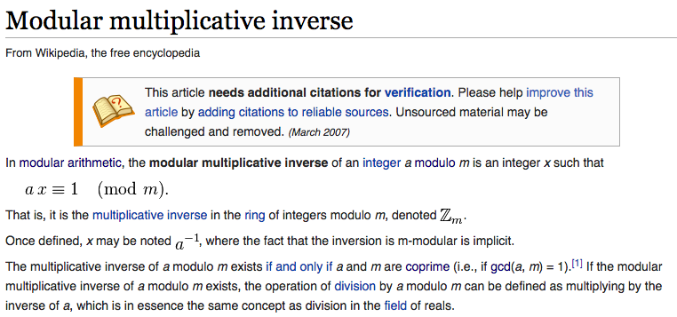
Known problem with known solutions
For the assignment, I’ve provided you with a function: inversemod

Slide 39
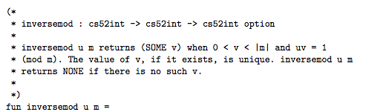
inversemod

Slide 40
Option type
Look at option.sml
http://www.cs.pomona.edu/~dkauchak/classes/cs52/examples/option.sml
option type has two constructors:
NONE (representing no value)
SOME v (representing the value v)

Slide 41
case statement
case _______ of
pattern1 => value
| pattern2 => value
| pattern3 => value
…

Slide 42
inversemod

Slide 43
Signing documents
If a message is encrypted with the private key how can it be decrypted?
I like bananas
Hint:
(m^{e})^{d} = m^{ed} = m (mod n)
encrypt(m, (e, n)) = m^{e} mod n
decrypt(z, (d, n)) = z^{d} mod n
encrypt message

Slide 44
Signing documents
(m^{e})^{d} = m^{ed} = m (mod n)
encrypt(m, (e, n)) = m^{e} mod n
decrypt(z, (d, n)) = z^{d} mod n
encrypt(m, (d,n)) = m^{d} mod n
decrypt( m^{d} mod n , (e, n)) =
(m^{d})^{e} mod n
= m^{de} mod n
= m^{ed} mod n
= m
(if m < n)

Slide 45
Signing documents
I like bananas
What does this do for us?
encrypt message

Slide 46
Signing documents
I like bananas
If the message can be decrypted with the public key then the sender must have had the private key
This is a way to digitally sign a document!
encrypt message

Slide 47
Signing documents
Confirmed: batman likes bananas
I like bananas
I like bananas
decrypt message
encrypt message
send signed message

Slide 48
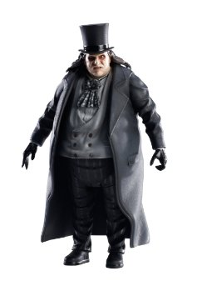
Signing documents
Confirmed: batman likes bananas
I like bananas
I like bananas
decrypt message
encrypt message
send signed message

Slide 49
Public key encryption
Share your public key with everyone
How does this happen?
Anything we have to be careful of?

Slide 50
What next…
More implementation details
characters to integers
splitting up the numbers
finding prime numbers
helper functions
option type
Key distribution
“signing” documents

