Slide 1
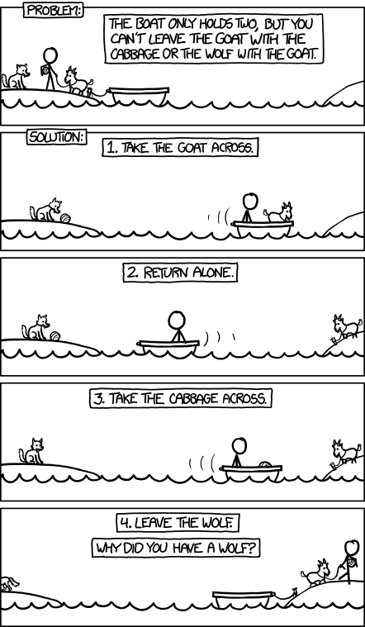
http://xkcd.com/1134/

Slide 2
Digital circuits
David Kauchak
CS52 – Fall 2015

Slide 3
Admin
Assignment 4 due Monday at 11:59pm
Assignment 5 posted soon
  due Friday Oct. 23rd, at 5pm
CS lunch today!

Slide 4
Midterm
Average: 23.25
Top quartile: 26
Top half (median): 24.6
Bottom quartile: 21.4

Slide 5

Diving into your computer

Slide 6
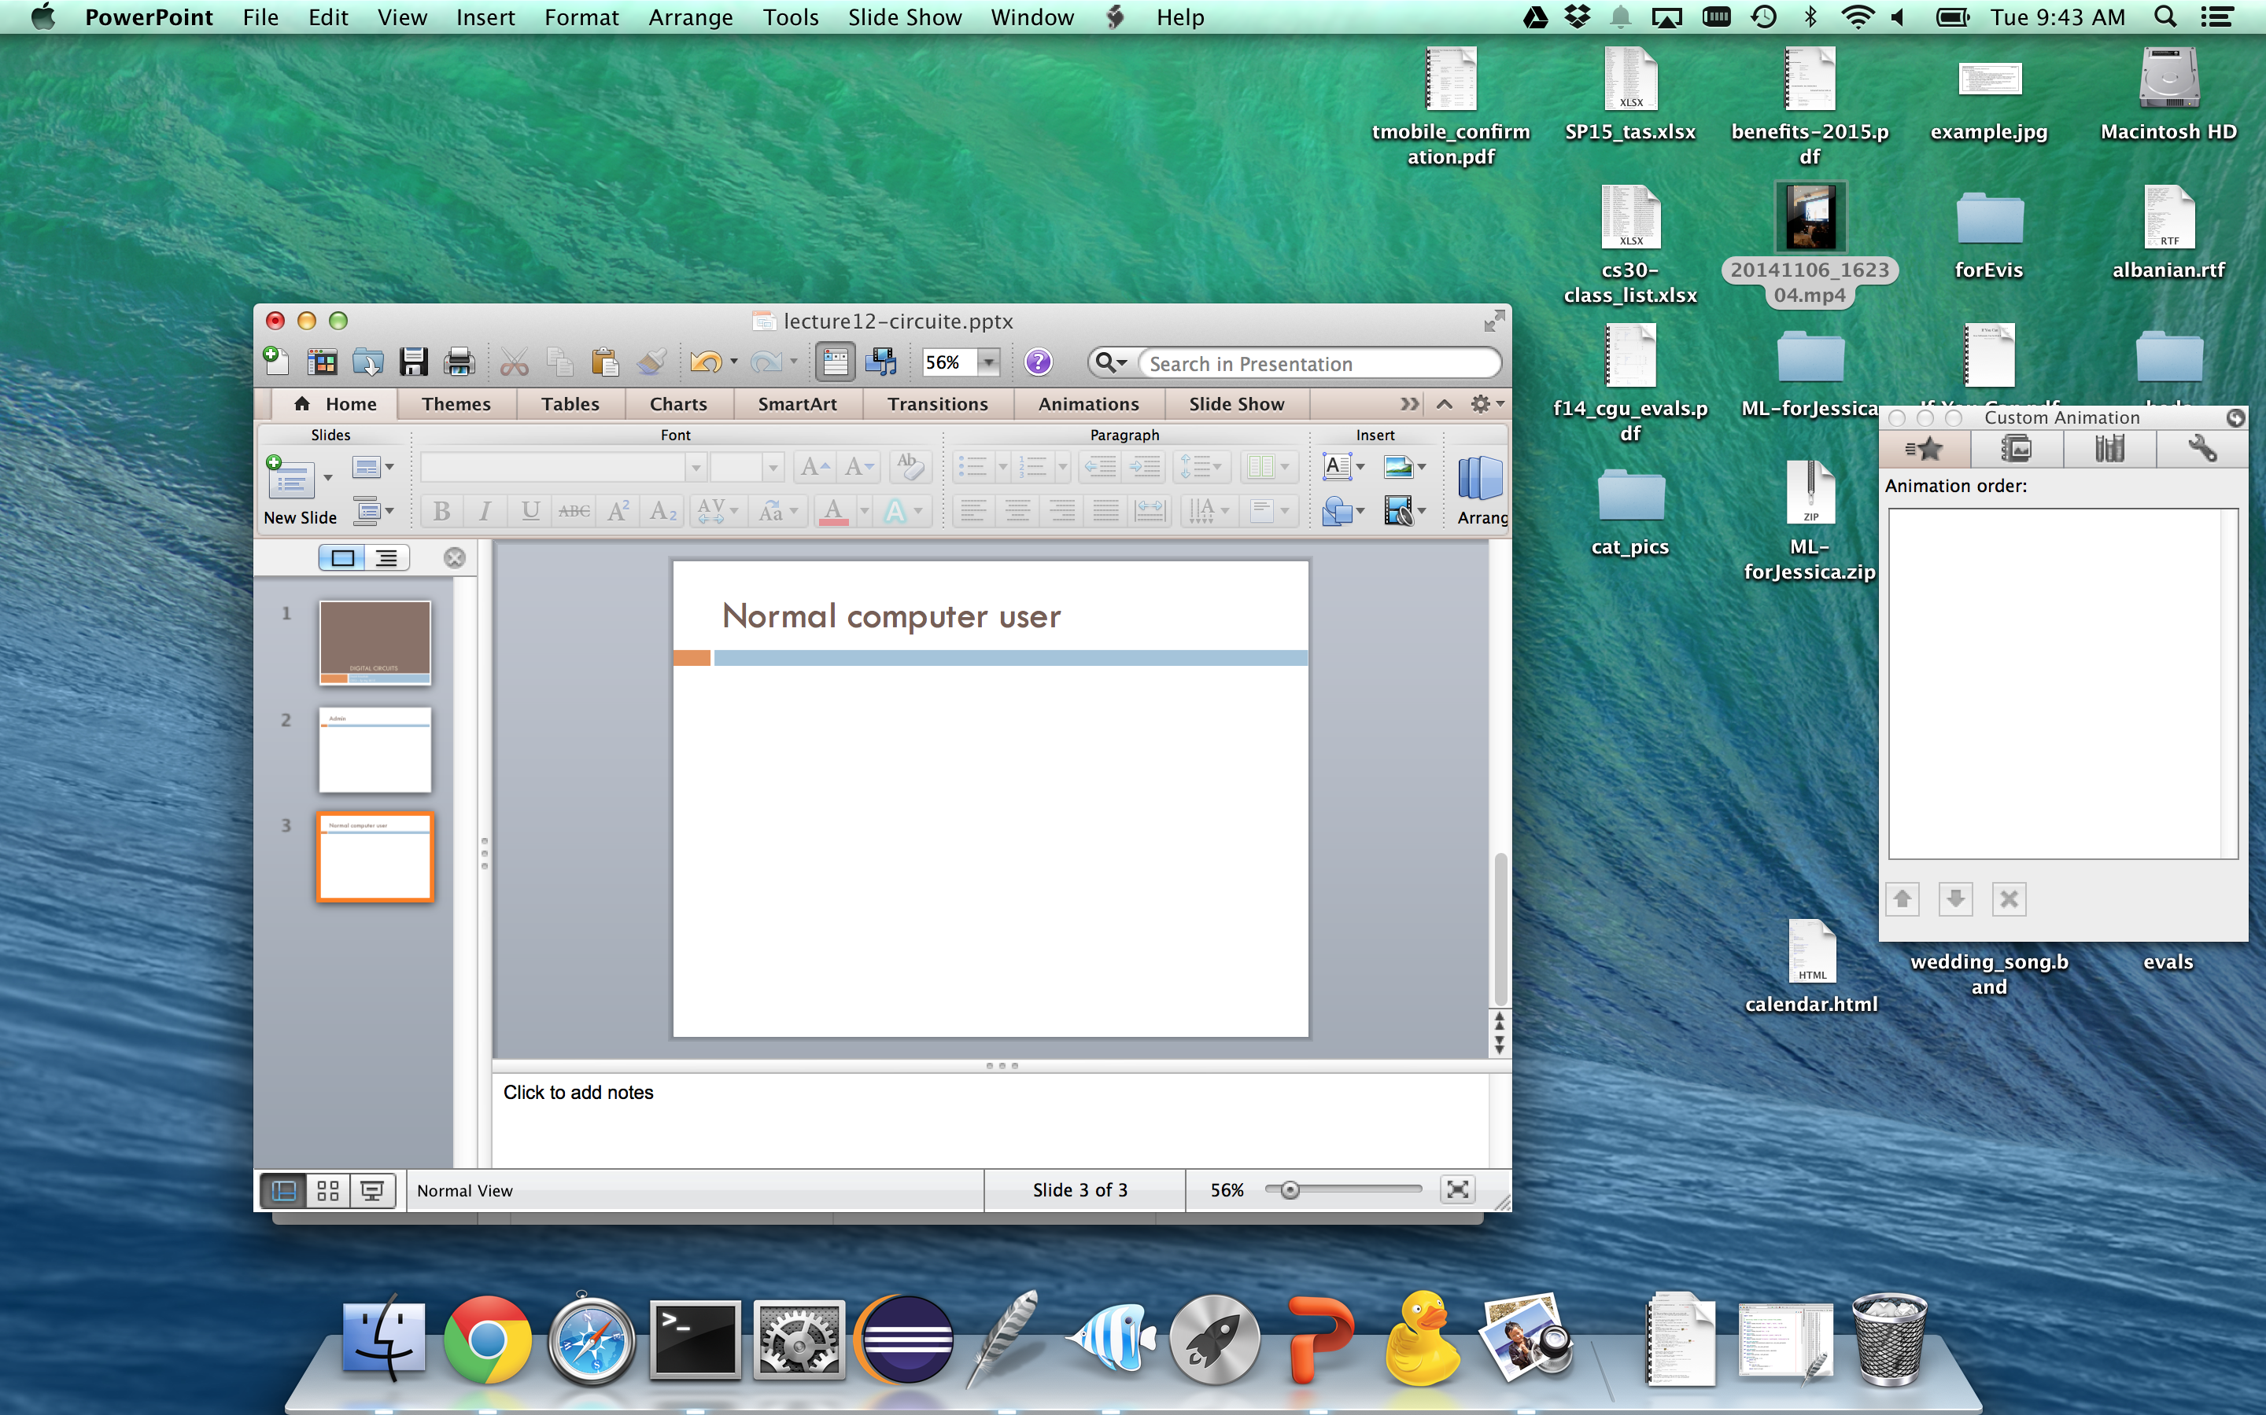
Normal computer user

Slide 7
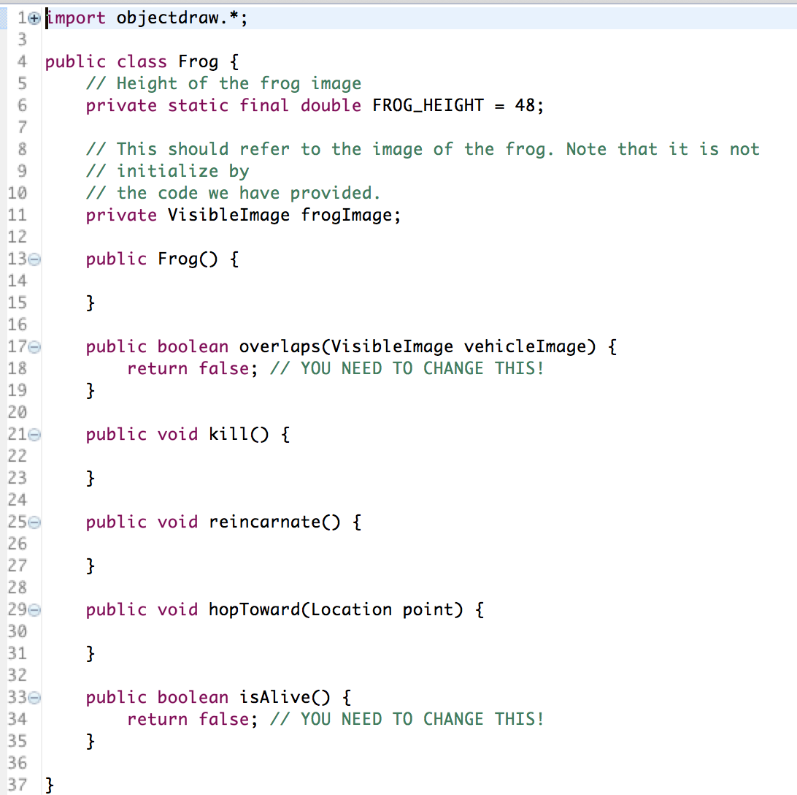
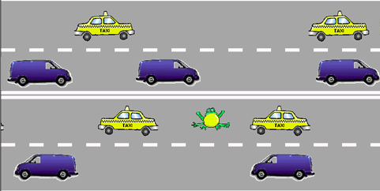
After intro CS

Slide 8
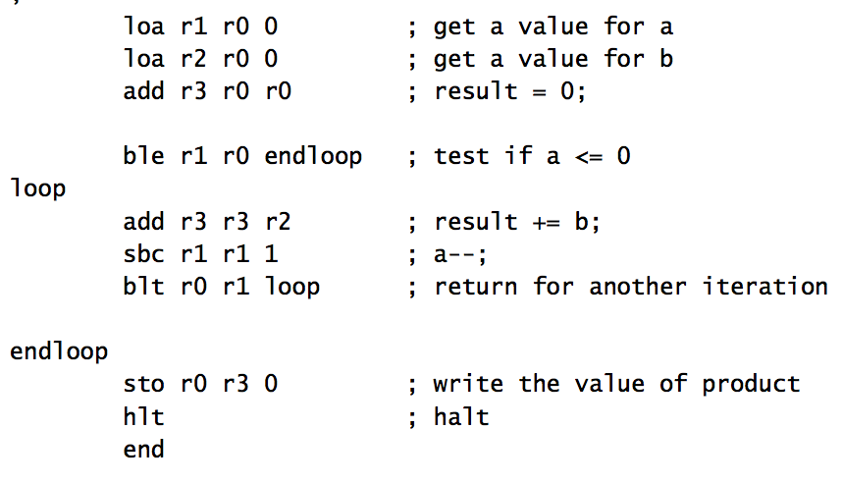
After 5 weeks of cs52

Slide 9
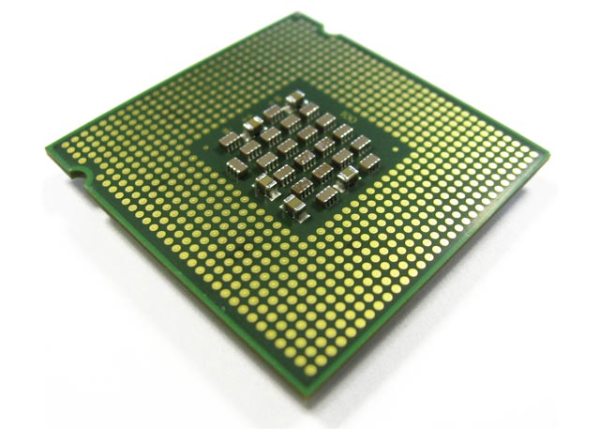
What now?

Slide 10
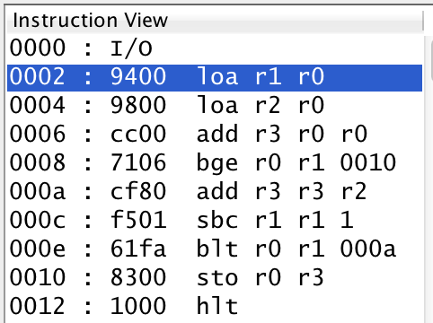
One last note on CS41B
memory address
binary representation of code
instructions (assembly code)
How do we get this?

Slide 11
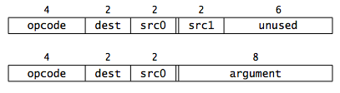
Encoding assembly instructions
1001 0100 0000 0000
1001 1000 0000 0000
1100 1100 0000 0000
opcode
dest
src0
src1

Slide 12
What now?
1001 0100 0000 0000
1001 1000 0000 0000
1100 1100 0000 0000

Slide 13
Review: binary addition
01010
01111
+
?
Do the binary addition, making sure to keep track of the carries.
Assume unsigned numbers for now.

Slide 14
Review: binary addition
1
1
1
0
01010
01111
+
11001
Just to be sure, what are these numbers in decimal?

Slide 15
Review: binary addition
1
1
1
0
01010
01111
10
+
15
11001
25
We saw before, that we can view this problem recursively. How?

Slide 16
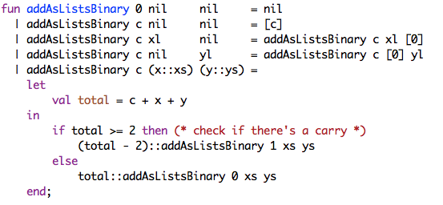

Slide 17
1
1
1
0
01010
01111
+
11001
handle a digit at a time

Slide 18
1
1
1
0
01010
01111
+
11001
generate two pieces of information
output bit
carry bit

Slide 19
A recursive component
1
1
1
0
01010
01111
+
11001
in1
in2
carry-in
carry-out
out

Slide 20
Adding with components
01010
01111
+
1
1
0
1
1
1
0
1
in1
in2
carry-in
in1
in2
carry-in
in1
in2
carry-in
in1
in2
carry-out
carry-out
carry-out
carry-out
out
out
out
out

Slide 21
Adding with components
01010
01111
+
1
1
0
1
1
1
0
1
in1
in2
carry-in
in1
in2
carry-in
in1
in2
carry-in
in1
in2
?
carry-out
carry-out
carry-out
carry-out
out
out
out
out
?

Slide 22
Adding with components
0
01010
01111
+
1
1
1
0
1
1
1
0
0
1
in1
in2
carry-in
in1
in2
carry-in
in1
in2
carry-in
in1
in2
?
carry-out
carry-out
carry-out
carry-out
out
out
out
out
?
1

Slide 23
Adding with components
1
0
01010
01111
+
0
1
1
1
0
1
1
1
1
0
0
1
in1
in2
carry-in
in1
in2
carry-in
in1
in2
carry-in
in1
in2
?
carry-out
carry-out
carry-out
carry-out
out
out
out
out
0
1
?

Slide 24
Adding with components
1
1
0
01010
01111
+
0
0
1
1
1
1
0
1
1
1
1
0
0
1
?
in1
in2
carry-in
in1
in2
carry-in
in1
in2
carry-in
in1
in2
carry-out
carry-out
carry-out
carry-out
out
out
out
out
?
0
0
1

Slide 25
Adding with components
1
1
1
0
01010
01111
+
1
1
0
0
1
1
1
1
0
1
1
1
1
0
0
1
1
in1
in2
carry-in
in1
in2
carry-in
in1
in2
carry-in
in1
in2
carry-out
carry-out
carry-out
carry-out
out
out
out
out
1
0
0
1

Slide 26
Implementing the component
in1
in2
carry-in
carry-out
out
What goes on inside the component?

Slide 27
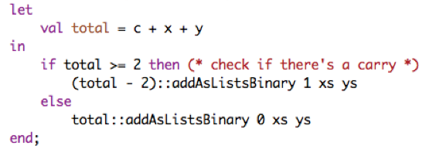
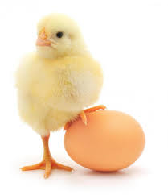
Implementing the component
in1
in2
carry-in
carry-out
out
Current implementation uses addition!

Slide 28
Implementing the component
in1 | in2 | carry-in | out | carry-out
0 | 0 | 0
0 | 0 | 1
0 | 1 | 0
0 | 1 | 1
1 | 0 | 0
1 | 0 | 1
1 | 1 | 0
1 | 1 | 1
in1
in2
carry-in
carry-out
out
What are the outputs?

Slide 29
Implementing the component
in1 | in2 | carry-in | out | carry-out
0 | 0 | 0 | 0 | 0
0 | 0 | 1 | 1 | 0
0 | 1 | 0 | 1 | 0
0 | 1 | 1 | 0 | 1
1 | 0 | 0 | 1 | 0
1 | 0 | 1 | 0 | 1
1 | 1 | 0 | 0 | 1
1 | 1 | 1 | 1 | 1
in1
in2
carry-in
carry-out
out

Slide 30
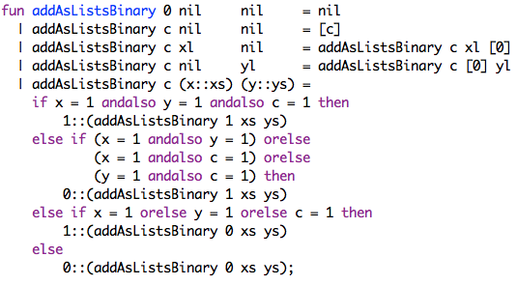
Another implementation
Don’t use addition anymore
Translated the problem into a boolean logic problem

Slide 31
What are some boolean operators?
A | B | A and B | A or B | not A
0 | 0 | 0 | 0 | 1
0 | 1 | 0 | 1 | 1
1 | 0 | 0 | 1 | 0
1 | 1 | 1 | 1 | 0

Slide 32
What are some boolean operators?
A | B | A and B | A or B | not A | A nand B | A nor B | A xor B
0 | 0 | 0 | 0 | 1 | 1 | 1 | 0
0 | 1 | 0 | 1 | 1 | 1 | 0 | 1
1 | 0 | 0 | 1 | 0 | 1 | 0 | 1
1 | 1 | 1 | 1 | 0 | 0 | 0 | 0

Slide 33
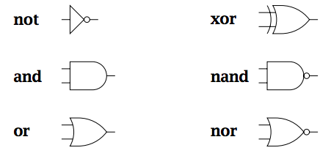
Gates
Gates have inputs and outputs
  values are 0 or 1
Are hardware components!

Slide 34
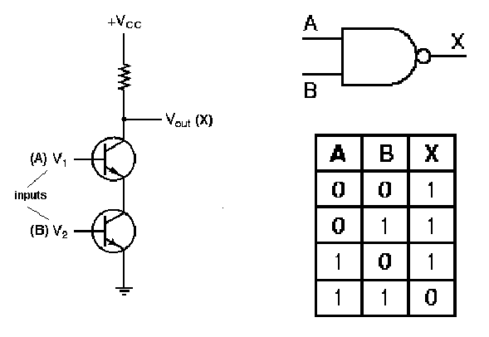
Gates as hardware

Slide 35
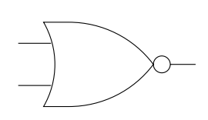
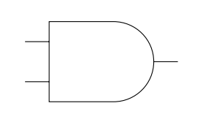
Utilizing gates
A | B | A and B | A or B | not A | A nand B | A nor B | A xor B
0 | 0 | 0 | 0 | 1 | 1 | 1 | 0
0 | 1 | 0 | 1 | 1 | 1 | 0 | 1
1 | 0 | 0 | 1 | 0 | 1 | 0 | 1
1 | 1 | 1 | 1 | 0 | 0 | 0 | 0
1
0
?
0

Slide 36
Utilizing gates
A | B | A and B | A or B | not A | A nand B | A nor B | A xor B
0 | 0 | 0 | 0 | 1 | 1 | 1 | 0
0 | 1 | 0 | 1 | 1 | 1 | 0 | 1
1 | 0 | 0 | 1 | 0 | 1 | 0 | 1
1 | 1 | 1 | 1 | 0 | 0 | 0 | 0
0
1
0
0
0

Slide 37
Utilizing gates
A | B | A and B | A or B | not A | A nand B | A nor B | A xor B
0 | 0 | 0 | 0 | 1 | 1 | 1 | 0
0 | 1 | 0 | 1 | 1 | 1 | 0 | 1
1 | 0 | 0 | 1 | 0 | 1 | 0 | 1
1 | 1 | 1 | 1 | 0 | 0 | 0 | 0
1
1
?
1

Slide 38
Utilizing gates
A | B | A and B | A or B | not A | A nand B | A nor B | A xor B
0 | 0 | 0 | 0 | 1 | 1 | 1 | 0
0 | 1 | 0 | 1 | 1 | 1 | 0 | 1
1 | 0 | 0 | 1 | 0 | 1 | 0 | 1
1 | 1 | 1 | 1 | 0 | 0 | 0 | 0
0
1
1
0
1
When is this circuit 1?

Slide 39
Utilizing gates
in1 | in2 | in3 | OUT
0 | 0 | 0 | 0
0 | 0 | 1 | 1
0 | 1 | 0 | 0
0 | 1 | 1 | 0
1 | 0 | 0 | 0
1 | 0 | 1 | 0
1 | 1 | 0 | 0
1 | 1 | 1 | 0
1
1
1
Notes:
nor is only true with inputs 0, 0
and gate will therefore only be true when in1 and in2 are both 0 and in3 is 1

Slide 40
Designing more interesting circuits
A | B | A and B | A or B | not A | A nand B | A nor B | A xor B
0 | 0 | 0 | 0 | 1 | 1 | 1 | 0
0 | 1 | 0 | 1 | 1 | 1 | 0 | 1
1 | 0 | 0 | 1 | 0 | 1 | 0 | 1
1 | 1 | 1 | 1 | 0 | 0 | 0 | 0
in1 | in2 | in3 | OUT
0 | 0 | 0 | 0
0 | 0 | 1 | 1
0 | 1 | 0 | 1
0 | 1 | 1 | 1
1 | 0 | 0 | 1
1 | 0 | 1 | 1
1 | 1 | 0 | 1
1 | 1 | 1 | 1
Design a circuit for this

Slide 41
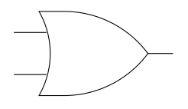
Designing more interesting circuits
in1 | in2 | in3 | OUT
0 | 0 | 0 | 0
0 | 0 | 1 | 1
0 | 1 | 0 | 1
0 | 1 | 1 | 1
1 | 0 | 0 | 1
1 | 0 | 1 | 1
1 | 1 | 0 | 1
1 | 1 | 1 | 1

Slide 42
Back to addition…
in1 | in2 | carry-in | carry-out | sum
0 | 0 | 0 | 0 | 0
0 | 0 | 1 | 0 | 1
0 | 1 | 0 | 0 | 1
0 | 1 | 1 | 1 | 0
1 | 0 | 0 | 0 | 1
1 | 0 | 1 | 1 | 0
1 | 1 | 0 | 1 | 0
1 | 1 | 1 | 1 | 1
in1
in2
carry-in
carry-out
out

Slide 43
A half-adder: no carry-in
A | B | carry | sum
0 | 0 | 0 | 0
0 | 1 | 0 | 1
1 | 0 | 0 | 1
1 | 1 | 1 | 0

Slide 44
A half-adder: no carry-in
A | B | A and B | A or B | not A | A nand B | A nor B | A xor B
0 | 0 | 0 | 0 | 1 | 1 | 1 | 0
0 | 1 | 0 | 1 | 1 | 1 | 0 | 1
1 | 0 | 0 | 1 | 0 | 1 | 0 | 1
1 | 1 | 1 | 1 | 0 | 0 | 0 | 0
A | B | carry | sum
0 | 0 | 0 | 0
0 | 1 | 0 | 1
1 | 0 | 0 | 1
1 | 1 | 1 | 0
Hint: solve each output bit independently
Design a circuit for this

Slide 45
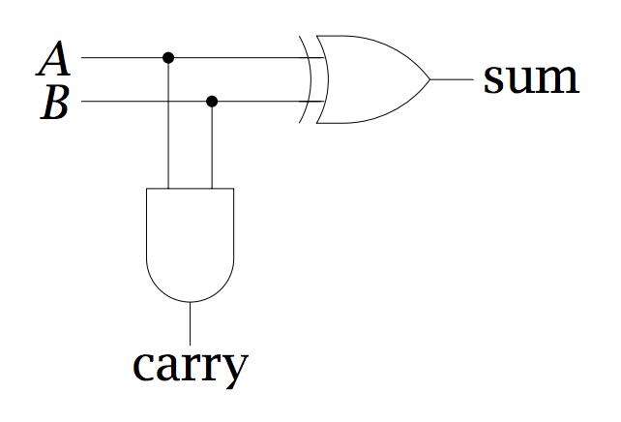
A half-adder: no carry-in
low order bit of A+B
A | B | carry | sum
0 | 0 | 0 | 0
0 | 1 | 0 | 1
1 | 0 | 0 | 1
1 | 1 | 1 | 0
higher order bit of A+B

Slide 46
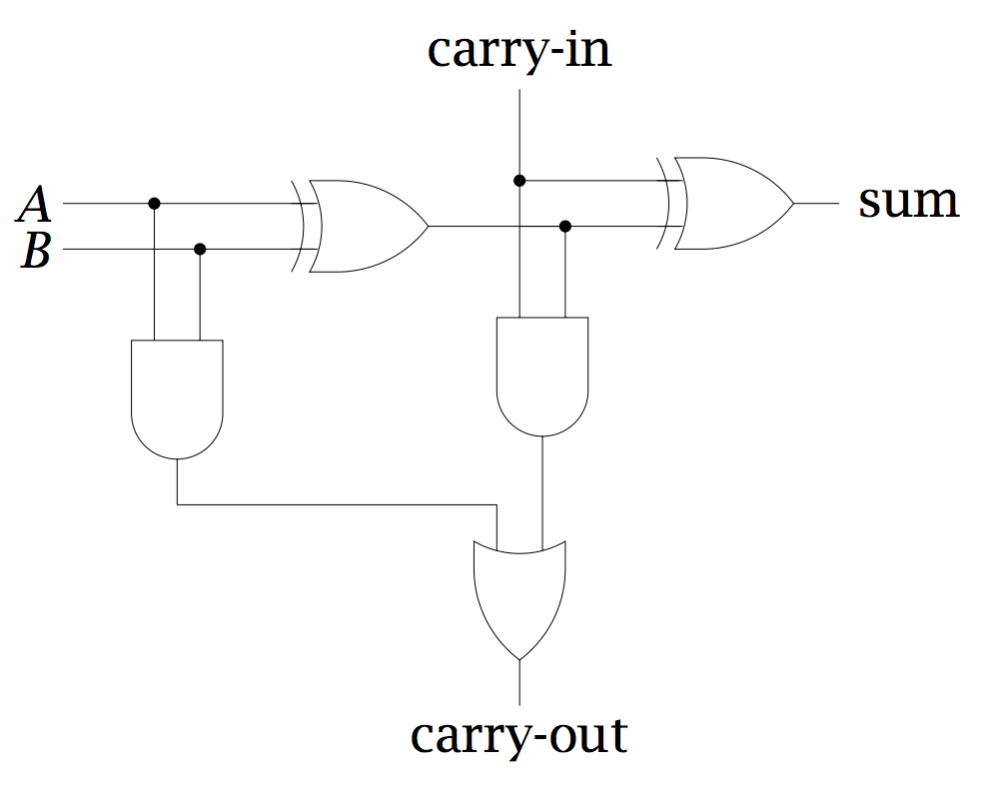
Implementing a full adder

Slide 47
Implementing a full adder
low order bit of A+B
low order bit of A+B+C
high order bit of A+B
Can I ever get a carry from both half adders?
high order bit of A+B+C

Slide 48
Implementing the component
in1
in2
carry-in
carry-out
out
What goes on inside the component?

Slide 49
Implementing the component
A
B
carry-in
carry-out
sum

Slide 50
Ripple carry adder
To implement an n-bit adder, we chain together n full- adders, each adder handles one bit position
A = A₃ A₂ A₁ A₀
Adder for adding 4-bit numbers
B = B₃ B₂ B₁ B₀
?
A₃
B₃
carry-in
A₂
B₂
carry-in
A₁
B₁
carry-in
A₀
B₀
carry-in
carry-out
carry-out
carry-out
carry-out
out
out
out
out

Slide 51
Ripple carry adder
To implement an n-bit adder, we chain together n full- adders, each adder handles one bit position
A = A₃ A₂ A₁ A₀
Adder for adding 4-bit numbers
B = B₃ B₂ B₁ B₀
0
A₃
B₃
carry-in
A₂
B₂
carry-in
A₁
B₁
carry-in
A₀
B₀
carry-in
carry-out
carry-out
carry-out
carry-out
out
out
out
out

Slide 52
Signed addition
0010
1110
+
?
Do the binary addition, making sure to keep track of the carries.
Assume signed numbers for now.

Slide 53
Signed addition
throw away last carry bit
1110
0010
1110
+
0000
Is that right?
What numbers are these?

Slide 54
Signed addition
1110
0010
1110
2
+
-2
0000
0
Ripple carry adder will work for signed and unsigned numbers

Slide 55
Subtraction
0010
1110
-
We can solve this doing addition

Slide 56
Subtraction
0010
1110
0010
0010
-
flip bits and add 1
0100
Do addition!

Slide 57
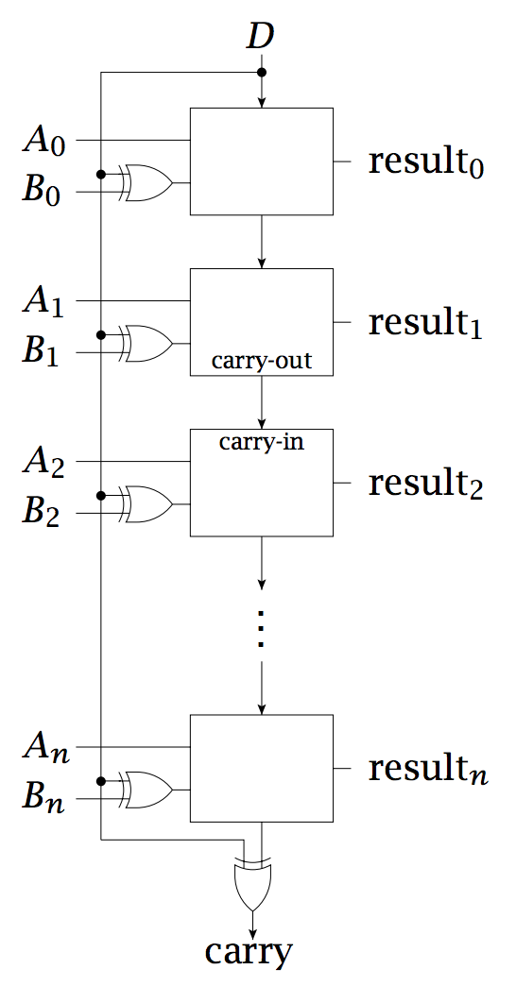
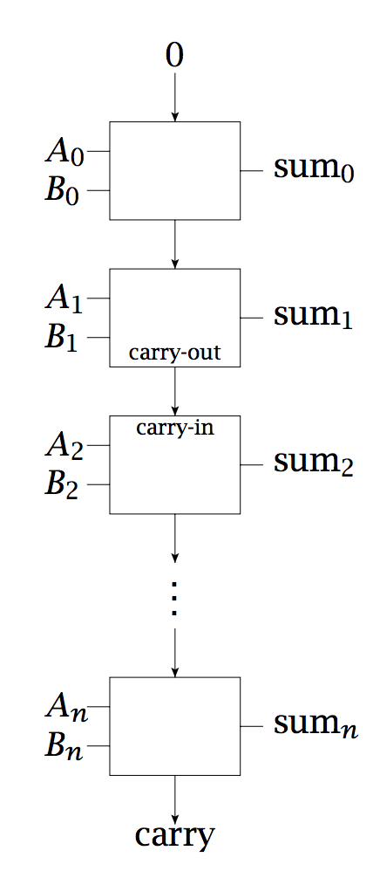
Ripple carry adder/subtractor
FA
FA
FA
FA
FA
FA
D = 0: addition
D = 1: subtraction
FA
FA
Why does this work?

Slide 58
Ripple carry adder/subtractor
If D = 0
  Carry in for first adder = 0
  B_{i} XOR 0 = B_{i}
If D = 1
  Carry in for first adder = 1
  (+1 to sum)
  B_{i} XOR 1 = NOT B_{i}
  (flip all the bits of B)
FA
FA
FA
FA

Slide 59
C, N, Z and V bits
In addition to the sum, we often also calculate some other useful information:
  C: carry out bit of the adder
  Z: 1 if the total result is zero, 0 otherwise
  N: sign bit of the result
  V: if there was “signed overflow”: the result cannot be represented with the number of bits we’re using
What are the cases where signed overflow can occur?

Slide 60
V bit
V: if there was “signed overflow”: the result cannot be represented with the number of bits we’re using
Adding two positive numbers (too big positive)
Subtracting a negative number from a positive number (too big positive)
Adding two negative numbers (too big negative)
Subtracting a positive number from a negative number (too big negative)

Slide 61
Detecting overflow
0011
0101
+
Add these (as signed numbers).
Does overflow occur?

Slide 62
Detecting overflow
111
0011
0101
+
1000
Yes. How do we detect it?

Slide 63
Detecting overflow
111
0011
0101
+
1000
- Added two positive numbers and got a negative
- In general: if the sign bits are the same (of the numbers we end up adding), but the higher order bit of result is different = overflow

Slide 64
Detecting overflow
0011
1001
-
Subtract these (as signed numbers).
Does overflow occur?

Slide 65
Detecting overflow
000
0011
1001
-
1010
Yes. How do we detect it?

Slide 66
Detecting overflow
000
0011
1001
-
1010
- Subtracted a negative number from a positive, should have been positive
- In general: if the sign bits are the different (of the numbers we end up subtracting), but the higher order bit of result is different = overflow

Slide 67
Detecting overflow
100
0011
1101
-
0110
- Subtracted a negative number from a positive
- In general: if the sign bits are the same (of the numbers we end up adding), but the higher order bit of result is different = overflow

Slide 68
Python basics

