Slide 1
MaxImum entropy
David Kauchak
CS457, Spring 2011
Some material derived from Jason Eisner

Slide 2
Linear classifier
A linear classifier predicts the label based on a weighted, linear combination of the features
For two classes, a linear classifier can be viewed as a plane (hyperplane) in the feature space
f₂
f₃
f₁

Slide 3
Linear regression
Predict the response based on a weighted, linear combination of the features
real value
weights
Learn weights by minimizing the square error on the training data

Slide 4
Logistic regression
…

Slide 5
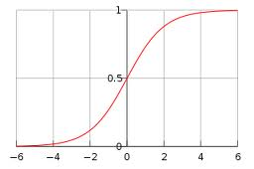
Logistic function

Slide 6
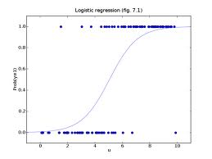
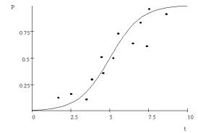
Logistic regression
Find the best fit of the data based on a logistic

Slide 7
Logistic regression
How would we classify examples once we had a trained model?
If the sum > 0 then p(1)/p(0) > 1, so positive
if the sum < 0 then p(1)/p(0) < 1, so negative
Still a linear classifier (decision boundary is a line)

Slide 8
3 views of logistic regression
linear classifier
…
exponential model (log-linear model)
…
logistic
Notes:
walk through the math here…

Slide 9
Logistic regression
Find the best fit of the data based on a logistic function

Slide 10
Training logistic regression models
How should we learn the parameters for logistic regression (i.e. the w’s)?
parameters

Slide 11
Training logistic regression models
Idea 1: minimize the squared error (like linear regression)
  Any problems?
  We don’t know what the actual probability values are!

Slide 12
A digression
Why is this called Maximum Likelihood Estimation (MLE)?
Parsed sentences
Grammar
S → NP VP
S → VP
NP → Det A N
NP → NP PP
NP → PropN
A → ε
A → Adj A
PP → Prep NP
VP → V NP
VP → VP PP
0.9
0.1
0.5
0.3
0.2
0.6
0.4
1.0
0.7
0.3
Learning/
Training
English
…

Slide 13
MLE
Maximum likelihood estimation picks the values for the model parameters that maximize the likelihood of the training data
S → NP VP
S → VP
NP → Det A N
NP → NP PP
NP → PropN
A → ε
A → Adj A
PP → Prep NP
VP → V NP
VP → VP PP
0.9
0.1
0.5
0.3
0.2
0.6
0.4
1.0
0.7
0.3
parameter values
parameters
model (Θ)

Slide 14
MLE
Maximum likelihood estimation picks the values for the model parameters that maximize the likelihood of the training data
parameters
parameter values
S → NP VP
S → VP
NP → Det A N
NP → NP PP
NP → PropN
A → ε
A → Adj A
PP → Prep NP
VP → V NP
VP → VP PP
0.9
0.1
0.5
0.3
0.2
0.6
0.4
1.0
0.7
0.3
If this is what you want to optimize, you can do NO BETTER than MLE!
model (Θ)

Slide 15
MLE example
You flip a coin 100 times. 60 times you get heads.
What is the MLE for heads?
  p(head) = 0.60
What is the likelihood of the data under this model (each coin flip is a data point)?
log(0.60⁶⁰ * 0.40⁴⁰) = -67.3

Slide 16
MLE Example
Can we do any better?
p(heads) = 0.5
  log(0.50⁶⁰ * 0.50⁴⁰) =-69.3
p(heads) = 0.7
  log(0.70⁶⁰ * 0.30⁴⁰)=-69.5

Slide 17
Training logistic regression models
Idea 1: minimize the squared error (like linear regression)
  We don’t know what the actual probability values are!
Ideas?

Slide 18
Training logistic regression models
Idea 2: maximum likelihood training
…
How do we solve this?

Slide 19
Training logistic regression models
Idea 2: maximum likelihood training
1. plug in our logistic equation
2. take partial derivatives and solve
…
Unfortunately, no closed form solution.

Slide 20
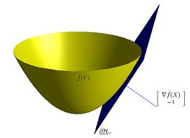
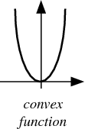
Convex functions
Convex functions look something like:
What are some nice properties about convex functions?
How can we find the minimum/maximum of a convex function?

Slide 21


Finding the minimum
You’re blindfolded, but you can see out of the bottom of the blindfold to the ground right by your feet. I drop you off somewhere and tell you that you’re in a convex shaped valley and escape is at the bottom/minimum. How do you get out?

Slide 22
One approach: gradient descent
Partial derivatives give us the slope in that dimension
Approach:
  pick a starting point (w)
  repeat until likelihood can’t increase in any dimension:
    pick a dimension
    move a small amount in that dimension towards increasing likelihood (using the derivative)

Slide 23
Gradient descent
  pick a starting point (w)
  repeat until loss doesn’t decrease in all dimensions:
    pick a dimension
    move a small amount in that dimension towards decreasing loss (using the derivative)
learning rate (how much we want to move in the error direction)

Slide 24
Solving convex functions
Gradient descent is just one approach
A whole field called convex optimization
  http://www.stanford.edu/~boyd/cvxbook/
Lots of well known methods
  Conjugate gradient
  Generalized Iterative Scaling (GIS)
  Improved Iterative Scaling (IIS)
  Limited-memory quasi-Newton (L-BFGS)
The key: if we get an error function that is convex, we can minimize/maximize it (eventually)

Slide 25

Another thought experiment
What is a 100,000-dimensional space like?
You’re a 1-D creature, and you decide to buy a 2-unit apartment
2 rooms (very, skinny rooms)

Slide 26
Another thought experiment
What is a 100,000-dimensional space like?
Your job’s going well and you’re making good money. You upgrade to a 2-D apartment with 2-units per dimension
4 rooms (very, flat rooms)

Slide 27
Another thought experiment
What is a 100,000-dimensional space like?
You get promoted again and start having kids and decide to upgrade to another dimension.
Each time you add a dimension, the amount of space you have to work with goes up exponentially
8 rooms (very, normal rooms)

Slide 28
Another thought experiment
What is a 100,000-dimensional space like?
Larry Page steps down as CEO of google and they ask you if you’d like the job. You decide to upgrade to a 100,000 dimensional apartment.
How much room do you have? Can you have a big party?
2^{100,000} rooms (it’s very quiet and lonely…) = ~10³⁰ rooms per person if you invited everyone on the planet

Slide 29
The challenge
Because logistic regression has fewer constraints (than, say NB) it has a lot more options
We’re trying to find 100,000 w values (or a point in a 100,000 dimensional space)
It’s easy for logistic regression to fit to nuances in the data: overfitting

Slide 30
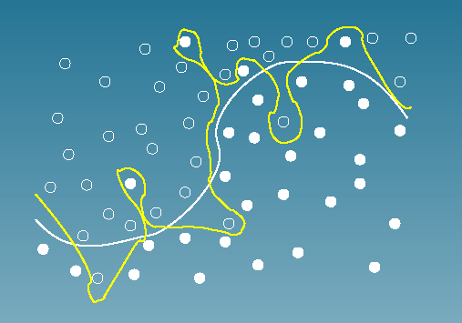
Overfitting
Given these points as training data, which is a better line to learn to separate the points?

Slide 31
Preventing overfitting
We want to avoid any single feature from having too much weight
normal MLE
ideas?

Slide 32
Preventing overfitting
We want to avoid any single feature from having too much weight
normal MLE
regularized MLE

Slide 33
Preventing overfitting: regularization
regularized MLE
What affect will this have on the learned weights assuming a positive α?
penalize large weights
encourage smaller weights
still a convex problem!
equivalent to assuming your w_{j} are distributed from a Gaussian with mean 0 (called a prior)

Slide 34
NB vs. Logistic regression
NB and logistic regression look very similar
  both are probabilistic models
  both are linear
  both learn parameters that maximize the log-likelihood of the training data
How are they different?

Slide 35
NB vs. Logistic regression
NB
Logistic regression
Estimates the weights under the strict assumption that the features are independent
Naïve bayes is called a generative model; it models the joint distribution p(features, labels)
If NB assumption doesn’t hold, we can adjust the weights to compensate for this
Logistic regression is called a discriminative model; it models the conditional distribution directly
p(labels | features)

Slide 36
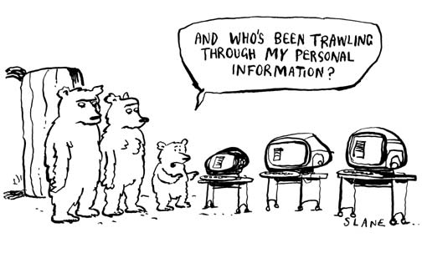
Some historical perspective
http://www.reputation.com/blog/2010/02/17/privacy-a-historical-perspective/

Slide 37
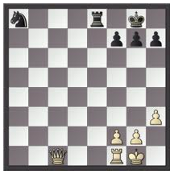
Estimating the best chess state
Write a function that takes as input a “state” representation of tic tac toe and scores how good it is for you if you’re X. How would you do it?
(Called a state evaluation function)

Slide 38
Old school optimization
Possible parses (or whatever) have scores
Pick the one with the best score
How do you define the score?
  Completely ad hoc!
  Throw anything you want into the mix
  Add a bonus for this, a penalty for that, etc.
  State evaluation function for chess…

Slide 39
Old school optimization
“Learning”
  adjust bonuses and penalties by hand to improve performance. ☺
Total kludge, but totally flexible too …
  Can throw in any intuitions you might have
But we’re purists… we only use probabilities!

Slide 40

New “revolution”?
Probabilities!

Slide 41
New “revolution”?
Exposé at 9
Probabilistic Revolution
Not Really a Revolution,
Critics Say
Probabilities no more
than scores in disguise
“We’re just adding stuff up like the old corrupt regime did,” admits spokesperson
Probabilities!

Slide 42
Probabilists Rally Behind Paradigm
83% of
^
“.2, .4, .6, .8! We’re not gonna take your bait!”
Can estimate our parameters automatically
  e.g., p(t7 | t5, t6) (trigram probability)
  from supervised or unsupervised data
Our results are more meaningful
  Can use probabilities to place bets, quantify risk
  e.g., how sure are we that this is the correct parse?
Our results can be meaningfully combined ⇒ modularity!
  Multiply indep. conditional probs – normalized, unlike scores
  p(English text) * p(English phonemes | English text) * p(Jap. phonemes | English phonemes) * p(Jap. text | Jap. phonemes)
  p(semantics) * p(syntax | semantics) * p(morphology | syntax) * p(phonology | morphology) * p(sounds | phonology)

Slide 43
Probabilists Regret Being Bound by Principle
Ad-hoc approach does have one advantage
Consider e.g. Naïve Bayes for spam categorization:
  Buy this supercalifragilistic Ginsu knife set for only $39 today …
Some useful features:
  Contains Buy
  Contains supercalifragilistic
  Contains a dollar amount under $100
  Contains an imperative sentence
  Reading level = 8th grade
  Mentions money (use word classes and/or regexp to detect this)
Any problem with these features for NB?

Slide 44
Probabilists Regret Being Bound by Principle
  Buy this supercalifragilistic Ginsu knife set for only $39 today …
Naïve Bayes
  Contains a dollar amount under $100
  Mentions money (use word classes and/or regexp to detect this)
 | Spam | not-Spam
< $100 | 0.5 | 0.02
Money amount | 0.9 | 0.1
How likely is it to see both features in either class using NB? Is this right?

Slide 45
Probabilists Regret Being Bound by Principle
  Buy this supercalifragilistic Ginsu knife set for only $39 today …
Naïve Bayes
  Contains a dollar amount under $100
  Mentions money (use word classes and/or regexp to detect this)
 | Spam | not-Spam
< $100 | 0.5 | 0.02
Money amount | 0.9 | 0.1
0.5*0.9=0.45
0.02*0.1=0.002
Overestimates! The problem is that the features are not independent

Slide 46
NB vs. Logistic regression
Logistic regression allows us to put in features that overlap and adjust the probabilities accordingly
Which to use?
  NB is better for small data sets: strong model assumptions keep the model from overfitting
  Logistic regression is better for larger data sets: can exploit the fact that NB assumption is rarely true

Slide 47
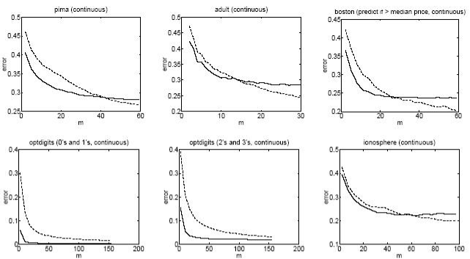
NB vs. Logistic regression

Slide 48
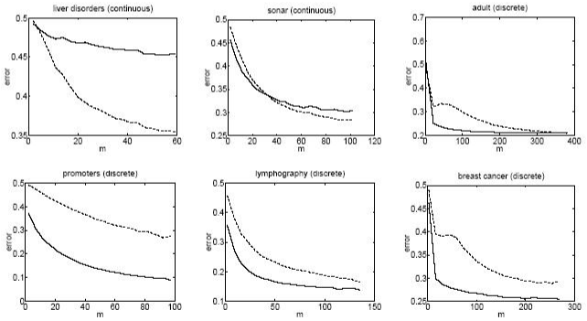
NB vs. Logistic regression

Slide 49
Logistic regression with more classes
NB works on multiple classes
Logistic regression only works on two classes
Idea: something like logistic regression, but with more classes
  Like NB, one model per each class
  The model is a weight vector
…
anything wrong with this?

Slide 50
Challenge: probabilistic modeling
…
These are supposed to be probabilities!
Ideas?

Slide 51
Maximum Entropy Modeling aka
Multinomial Logistic Regression
Normalize each class probability by the sum over all the classes
normalizing constant

Slide 52
Log-linear model
- still just a linear combination of feature weightings
class specific features

Slide 53
Training the model
Can still use maximum likelihood training
Use regularization
Plug into a convex optimization package
  there are a few complications, but this is the basic idea

Slide 54
Maximum Entropy
Suppose there are 10 classes, A through J.
I don’t give you any other information.
Question: Given a new example m: what is your guess for p(C | m)?
Suppose I tell you that 55% of all examples are in class A.
Question: Now what is your guess for p(C | m)?
Suppose I also tell you that 10% of all examples contain Buy and 80% of these are in class A or C.
Question: Now what is your guess for p(C | m),
if m contains Buy?

Slide 55
Maximum Entropy
 | A | B | C | D | E | F | G | H | I | J
prob | 0.1 | 0.1 | 0.1 | 0.1 | 0.1 | 0.1 | 0.1 | 0.1 | 0.1 | 0.1
Qualitatively
Maximum entropy principle: given the constraints, pick the probabilities as “equally as possible”
Quantitatively
Maximum entropy: given the constraints, pick the probabilities so as to maximize the entropy

Slide 56
Maximum Entropy
 | A | B | C | D | E | F | G | H | I | J
prob | 0.55 | 0.05 | 0.05 | 0.05 | 0.05 | 0.05 | 0.05 | 0.05 | 0.05 | 0.05
Qualitatively
Maximum entropy principle: given the constraints, pick the probabilities as “equally as possible”
Quantitatively
Maximum entropy: given the constraints, pick the probabilities so as to maximize the entropy

Slide 57
Maximum Entropy
 | A | B | C | D | E | F | G | H | I | J
Buy | .051 | .0025 | .029 | .0025 | .0025 | .0025 | .0025 | .0025 | .0025 | .0025
Other | .499 | .0446 | .0446 | .0446 | .0446 | .0446 | .0446 | .0446 | .0446 | .0446
Column A sums to 0.55 (“55% of all messages are in class A”)

Slide 58
Maximum Entropy
 | A | B | C | D | E | F | G | H | I | J
Buy | .051 | .0025 | .029 | .0025 | .0025 | .0025 | .0025 | .0025 | .0025 | .0025
Other | .499 | .0446 | .0446 | .0446 | .0446 | .0446 | .0446 | .0446 | .0446 | .0446
Column A sums to 0.55
Row Buy sums to 0.1 (“10% of all messages contain Buy”)

Slide 59
Maximum Entropy
 | A | B | C | D | E | F | G | H | I | J
Buy | .051 | .0025 | .029 | .0025 | .0025 | .0025 | .0025 | .0025 | .0025 | .0025
Other | .499 | .0446 | .0446 | .0446 | .0446 | .0446 | .0446 | .0446 | .0446 | .0446
Column A sums to 0.55
Row Buy sums to 0.1
(Buy, A) and (Buy, C) cells sum to 0.08 (“80% of the 10%”)
Given these constraints, fill in cells “as equally as possible”: maximize the entropy (related to cross-entropy, perplexity)
Entropy = -.051 log .051 - .0025 log .0025 - .029 log .029 - …
Largest if probabilities are evenly distributed

Slide 60
Maximum Entropy
 | A | B | C | D | E | F | G | H | I | J
Buy | .051 | .0025 | .029 | .0025 | .0025 | .0025 | .0025 | .0025 | .0025 | .0025
Other | .499 | .0446 | .0446 | .0446 | .0446 | .0446 | .0446 | .0446 | .0446 | .0446
Column A sums to 0.55
Row Buy sums to 0.1
(Buy, A) and (Buy, C) cells sum to 0.08 (“80% of the 10%”)
Given these constraints, fill in cells “as equally as possible”: maximize the entropy
Now p(Buy, C) = .029 and p(C | Buy) = .29
We got a compromise: p(C | Buy) < p(A | Buy) < .55

Slide 61
Generalizing to More Features
<$100
Other
 | A | B | C | D | E | F | G | H | …
Buy | .051 | .0025 | .029 | .0025 | .0025 | .0025 | .0025 | .0025
Other | .499 | .0446 | .0446 | .0446 | .0446 | .0446 | .0446 | .0446

Slide 62
What we just did
For each feature (“contains Buy”), see what fraction of training data has it
Many distributions p(c,m) would predict these fractions
Of these, pick distribution that has max entropy
Amazing Theorem: The maximum entropy model is the same as the maximum likelihood model!
  If we calculate the maximum likelihood parameters, we’re also calculating the maximum entropy model

Slide 63
What to take home…
Many learning approaches
  Bayesian approaches (of which NB is just one)
  Linear regression
  Logistic regression
  Maximum Entropy (multinomial logistic regression)
  SVMs
  Decision trees
  …
Different models have different strengths/weaknesses/uses
  Understand what the model is doing
  Understand what assumptions the model is making
  Pick the model that makes the most sense for your problem/data
Feature selection is important

Slide 64
Articles discussion
http://gigaom.com/mobile/wilson-siri-call-911/

